Slide 1
Advancing Healthy and Sustainable Diets for All
A Mindful Eating and Community Engagement Project

Slide 2
WHY ARE YOU HERE?
We want to provide you and your family with healthy foods over the course of 12 weeks.
We want to provide you and your family with nutrition classes to improve your knowledge of nutrition, cooking, and sustainable food systems.
We want to understand how increasing access to these two resources will affect your health and well being over time.

Slide 3
WHY ARE WE DOING THIS?
Our current food system does not meet the needs of human health or environmental health. It is UNSUSTAINABLE. The goal of this project is to incorporate sustainability concepts into our diets.

Slide 4
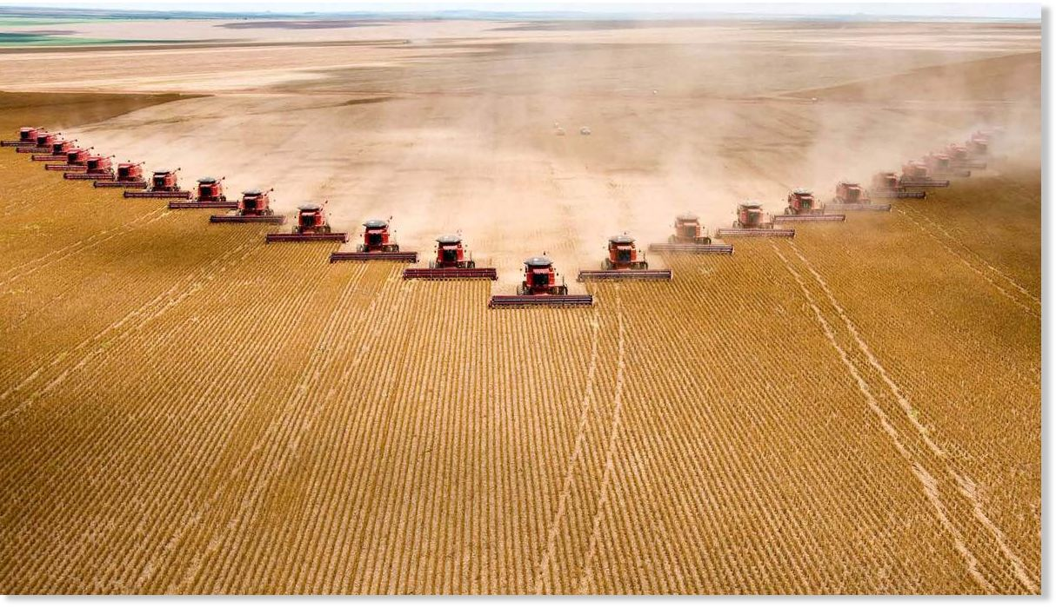
FOOD SYSTEMS AND ENVIRONMENTAL HEALTH
Agriculture has a HUGE environmental impact. It is responsible for:
30% greenhouse gas emissions
92% of global water use
Requires 38% of ice-free land on Earth
Of this, 22% is used for livestock grazing and one-third of crops grown are used to feed animals
Causes soil degradation and biodiversity loss

Slide 5
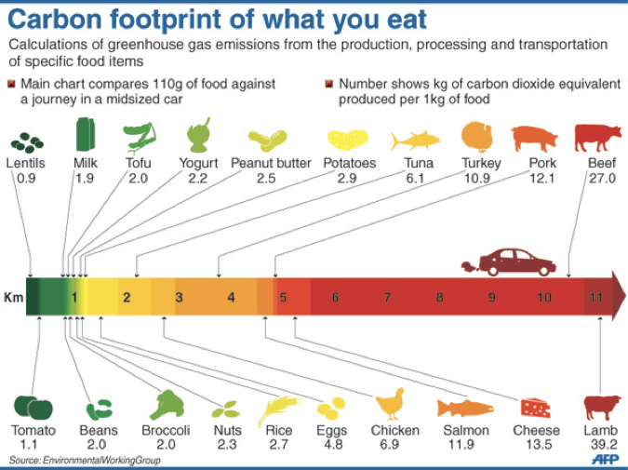
FOOD PRODUCTION PLACES GREATER STRESS ON THE ENVIRONMENT THAN ANY OTHER ACTIVITY
Consuming a plant-based diet is one of the best ways you can reduce your impact on the environment and climate change.
Try to eat more foods in the green and yellow categories and less in the orange and red categories.
You can still eat meat! But try to incorporate other food groups like fruits vegetables, legumes, nuts and seeds as much as possible.

Slide 6
FOOD SYSTEMS AND HUMAN HEALTH
Americans are experiencing a Nutrition Transition
Nutrition Transition: the process in which populations shift over time from local, place-based diets, to more diverse diets from various sources, but eventually to mass consumption of foods high in sugars, fats and salt (because they are mass produced and cheap).
The result is obesity and diet-related chronic diseases such as type II diabetes, high blood pressure, high cholesterol, and cardiovascular disease.
Notes:
“According to the World Health Organization, worldwide obesity has doubled since 1980.

Slide 7
FOOD SYSTEMS AND INEQUITY
Inequalities in our food system happen when certain populations or communities lack access to safe, affordable, and healthy foods.
This can lead to food insecurity, undernourishment, obesity, and diet-related chronic disease.
In the United States, 11% of households are food insecure.
BUT HERE IN THIS COMMUNITY THAT NUMBER IS MUCH HIGHER!
From 2015-2018 we have consistently found that half of our participant on the Flathead Reservation have been food insecure at some point throughout the year.

Slide 8
WHAT CAN WE DO TO MAKE OUR FOOD SYSTEM MORE SUSTAINABLE?
Embrace ONE HEALTH- the idea that the health of humans is interconnected with the health plants, animals, and the environment.
Practice SUSTAINABLE DIETS. Sustainable are “diets from sustainable food systems that enhance the human condition and conserve ecological resources in socially acceptable ways.” (Ahmed and Byker Shanks, 2019)
In this class, we will teach you core concepts of sustainable diets, and give you tools and resources to shop and cook in ways that benefit your health and the health of the environment.
We want to track your health and well being before, during, and after our ten weeks of classes to understand how this changes over time.

Slide 9
MIND MAPPING ACTIVITY: 1) WHAT DOES A SUSTAINABLE DIET LOOK LIKE TO YOU? 2) WHAT ARE THE HEALTH AND ENVIRONMENTAL BENEFITS?
Make a list or draw pictures of foods and beverages that are plant-based, diverse, and nutrient-dense
Can you think of some of the nutrition and health benefits of each of these foods?
Can you think of the environmental impacts of eating these foods? Where did they come from? Close by? Far away? Can they be found locally?
How much water and resources do you think is required for these foods? Do some require more over others?
What are the social and economic impacts of consuming these foods? Are they affordable for your family? Will your family eat them?

Slide 10
MIND MAPPING ACTIVITY 1) What are current diets in this community and how do they contribute to ONE HEALTH? 2) What are the health and environmental impacts?
Make a list or draw pictures of foods and beverages that are commonly consumed in your community or in society in general. How do they compare to the foods we listed in the previous activity?
Can you think of some of the nutrition and health benefits of each of these foods?
Can you think of the environmental impacts of eating these foods? Where did they come from? Close by? Far away? Can they be found locally?
How much water and resources do you think is required for these foods? Do some require more over others?
What are the social and economic impacts of consuming these foods? Are they affordable for your family? Will your family eat them?

