Slide 3
Advancing Healthy and Sustainable Diets for All
Lesson 9: Interacting with your Food Environments
With Ian Issaia McRyhew

Slide 4
Lesson 8: Food Environments
demonstrate the role of the food environment in influencing food and beverage choices
provide cooking demonstrations that help busy families on the go
provide introductory skills, information, and self-efficacy to facilitate positive interactions with the food environment
inspire consumer advocacy for a healthy and sustainable food environment and food system

Slide 5
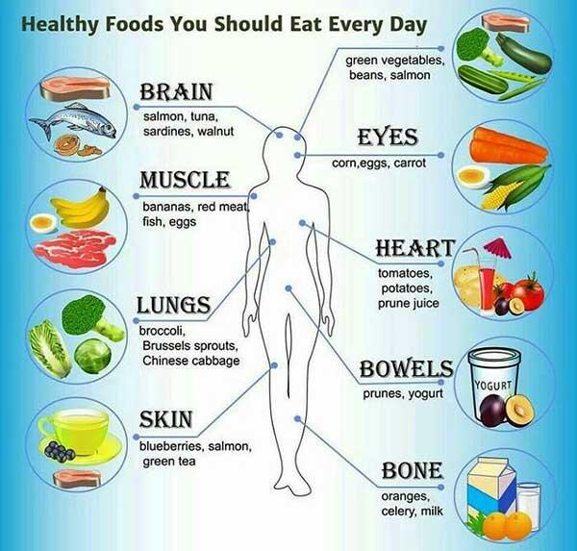
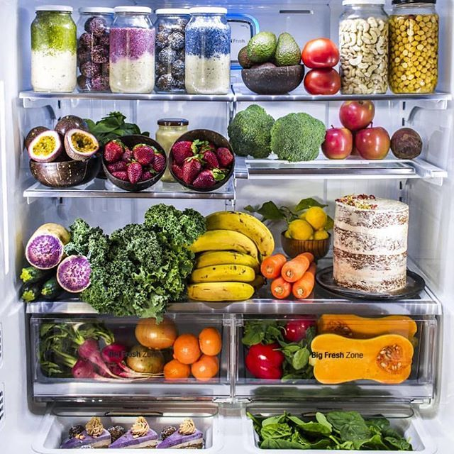
First
Second
Third
https://twitter.com/dailyhealthtips/status/478220575815786496
https://mundellassociates.com/science-environment/innovative-performance-optimization-of-food-water-energy-system-simulation-agro-ibis/
https://www.pinterest.com/pin/295689531781019507/

Slide 6
https://www.anh-academy.org/

Slide 7
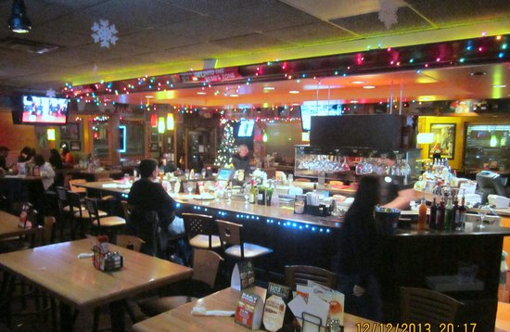
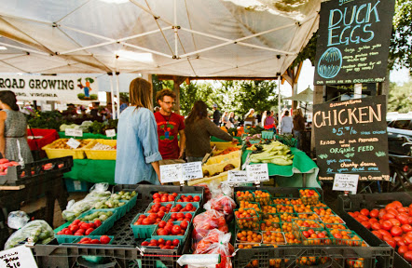
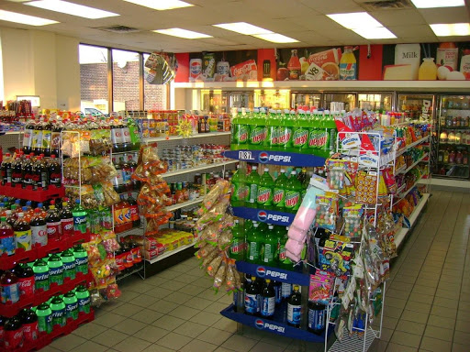
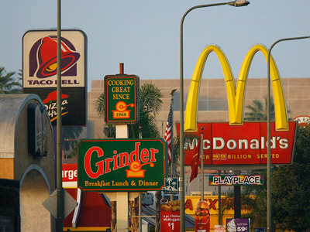

Slide 8
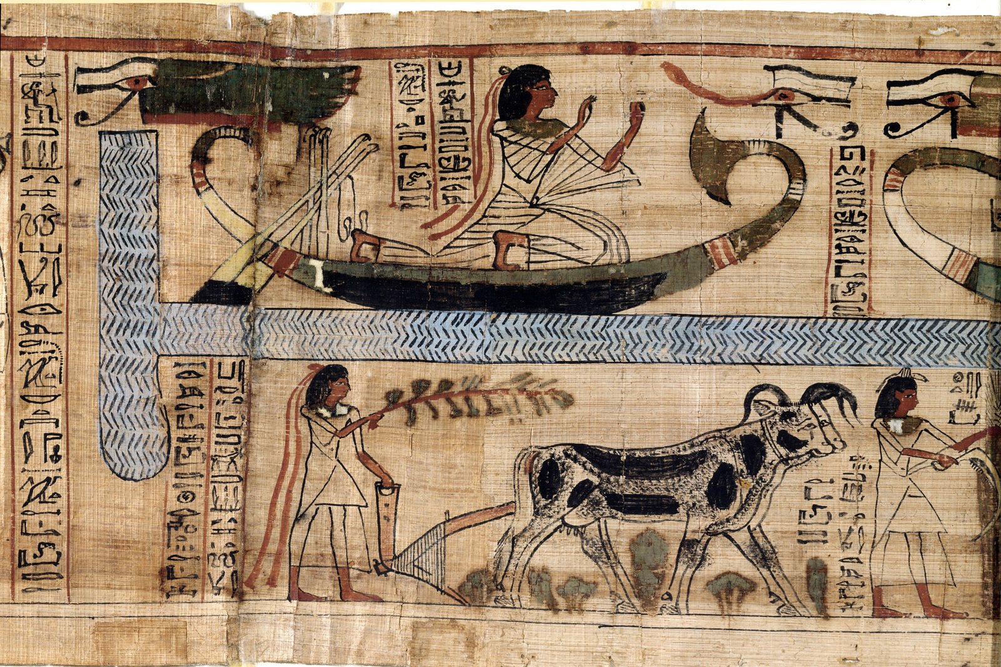
When Humans Quit Hunting And Gathering, Their Bones Got Wimpy
Farming helped fuel the rise of civilizations, but it may also have given us less robust bones.
Leemage/UIG via Getty Images
https://www.npr.org/sections/health-shots/2014/12/22/372441550/when-humans-quit-hunting-and-gathering-their-bones-got-wimpy

Slide 9
THE FOOD ENVIRONMENT
When choosing which foods to eat- availability, affordability, convenience, and desirability of foods in certain settings influences our decision-making.

Slide 10
Grocery shopping

Slide 11
 | Available | Affordable | Convenient | Desirable
Question Prompt | Do you think healthy and sustainable foods are available in the community? How so? What are the barriers? | Do you think healthy and sustainable foods are affordable in the community? How so? What are the barriers? | Do you think healthy and sustainable foods are easily obtained in the community? How so? What are the barriers? | Do you think healthy and sustainable foods are desirable in the community? Desirable means good quality and the type of food preferred. How so? What are the barriers?
Ways the food environment IS accommodating to sustainable food systems
Ways the food environment is NOT accommodating to sustainable food systems
Things consumers can do to advocate or navigate for the food environment to be more sustainable

Slide 12
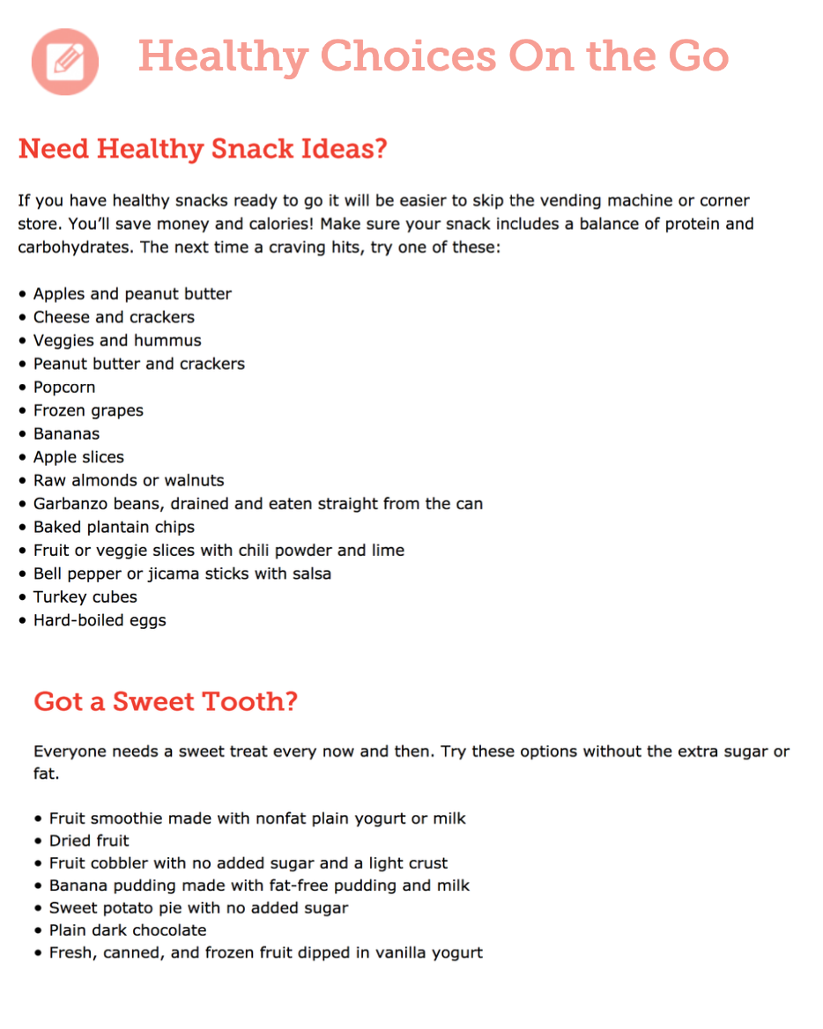
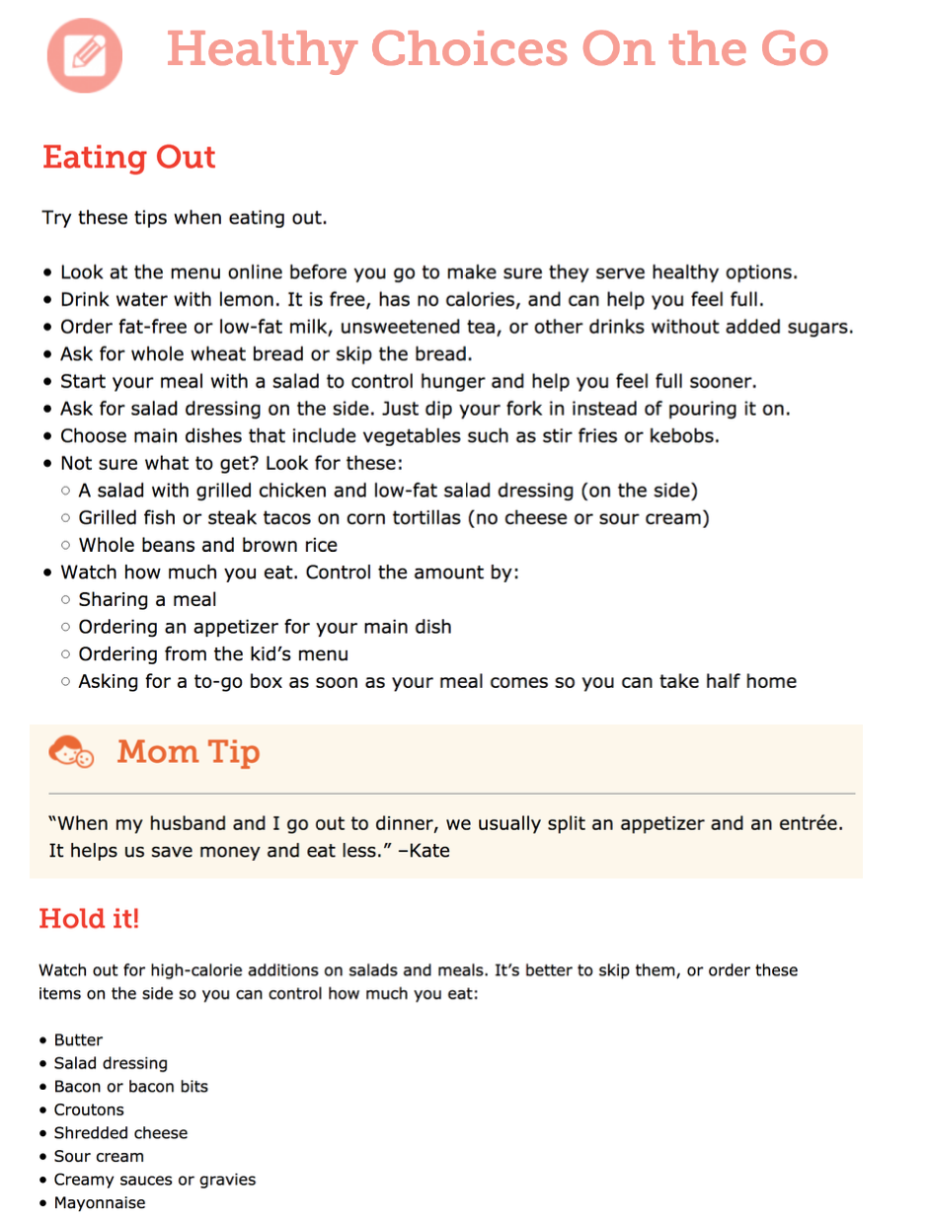
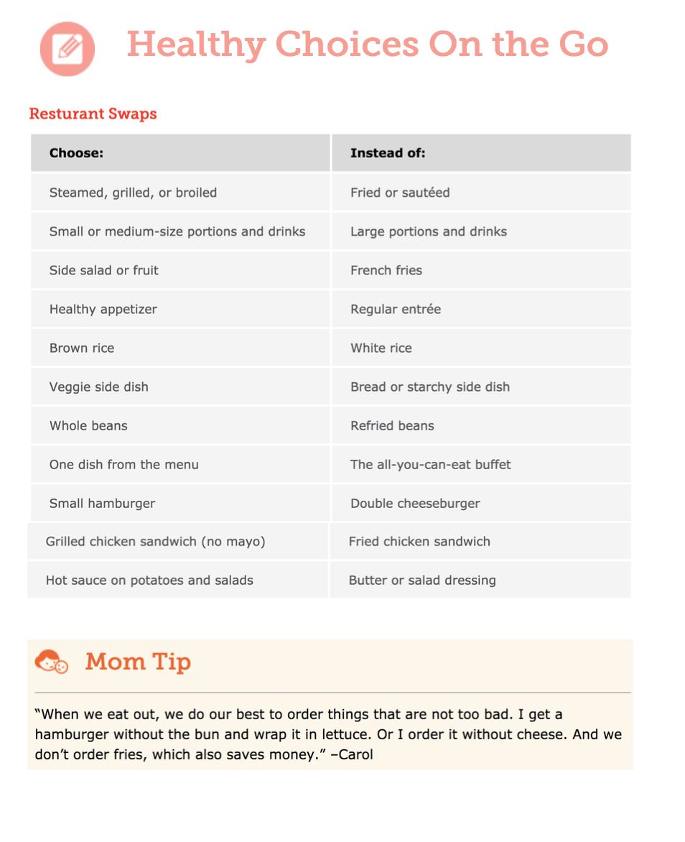

Slide 13
Eating OuT

Slide 14
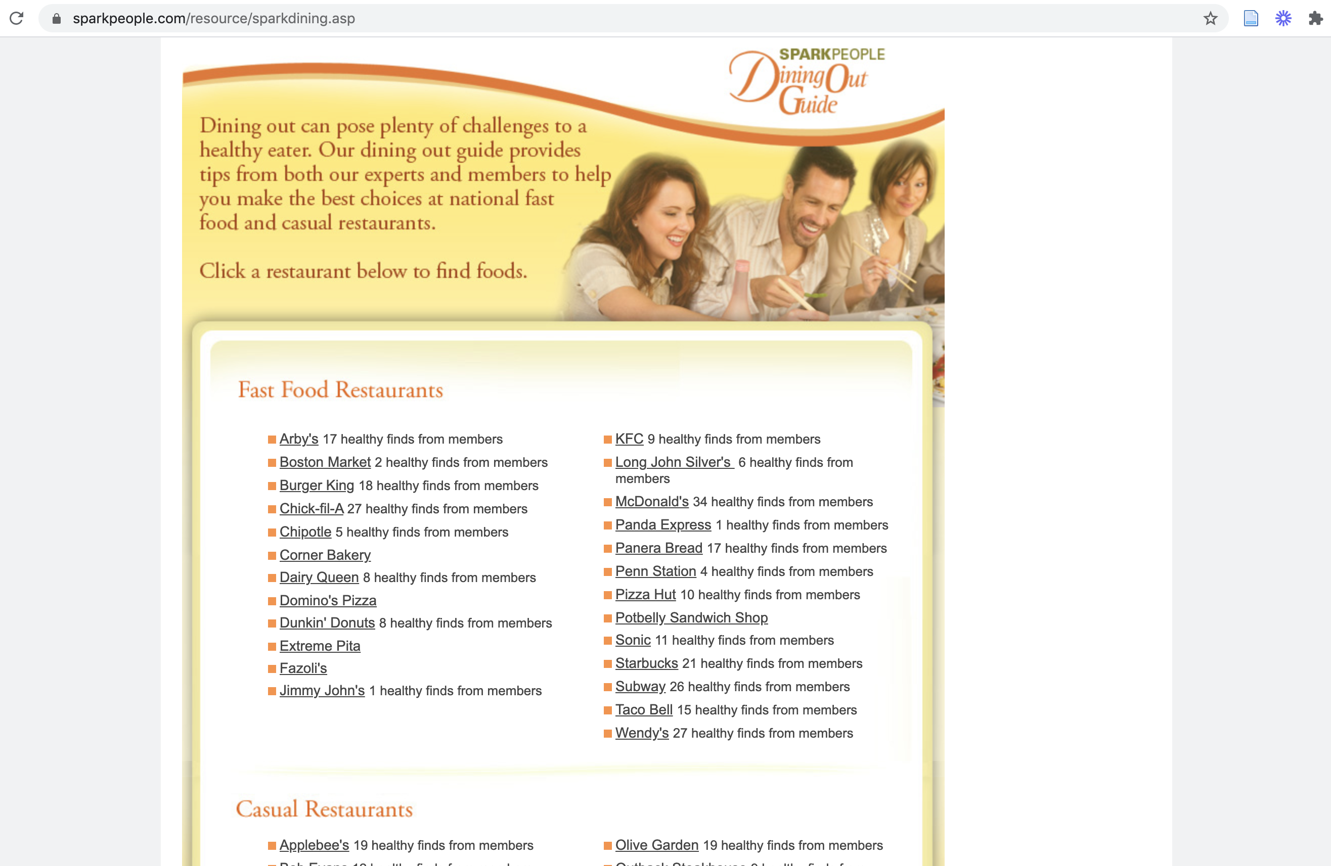
https://www.sparkpeople.com/resource/sparkdining.asp

Slide 15
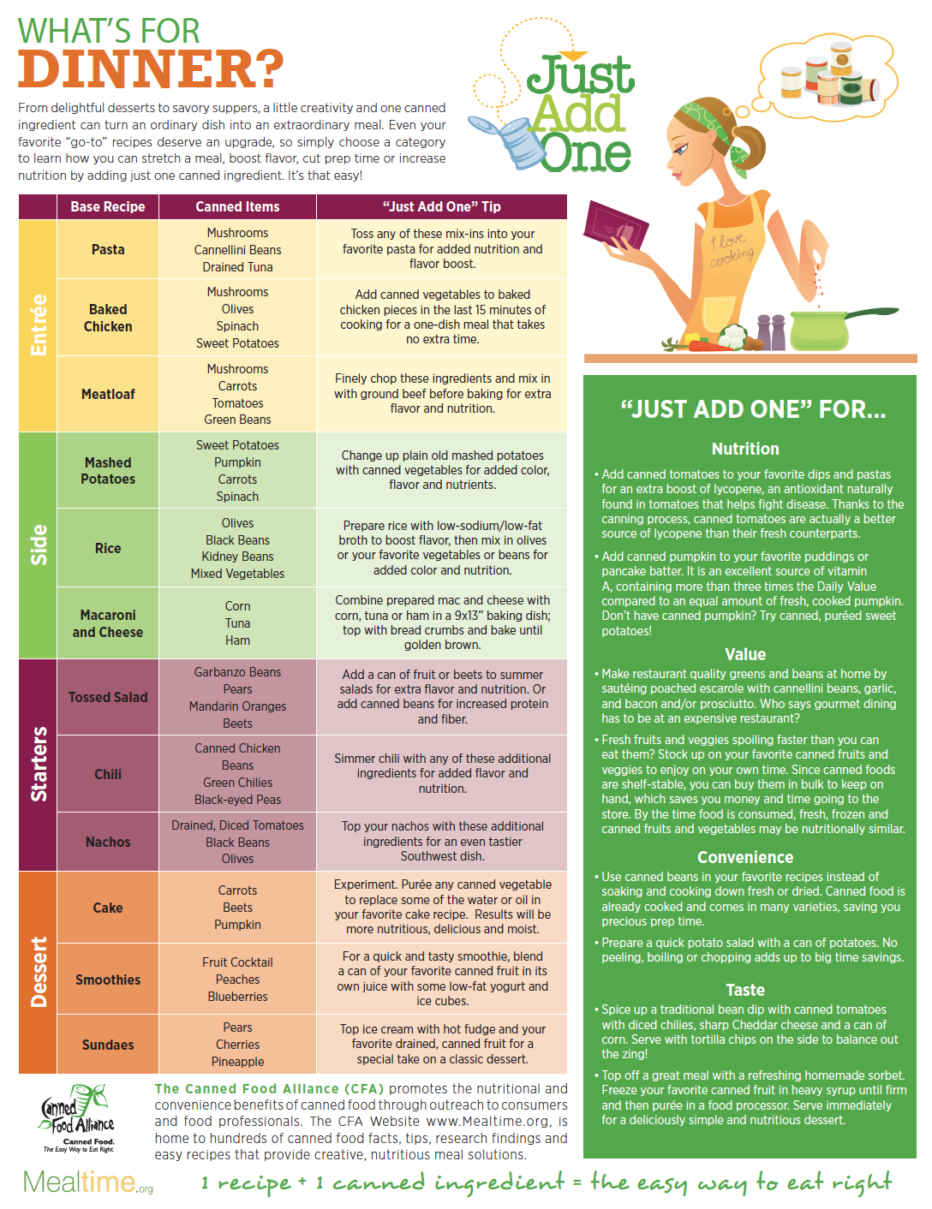

Slide 16
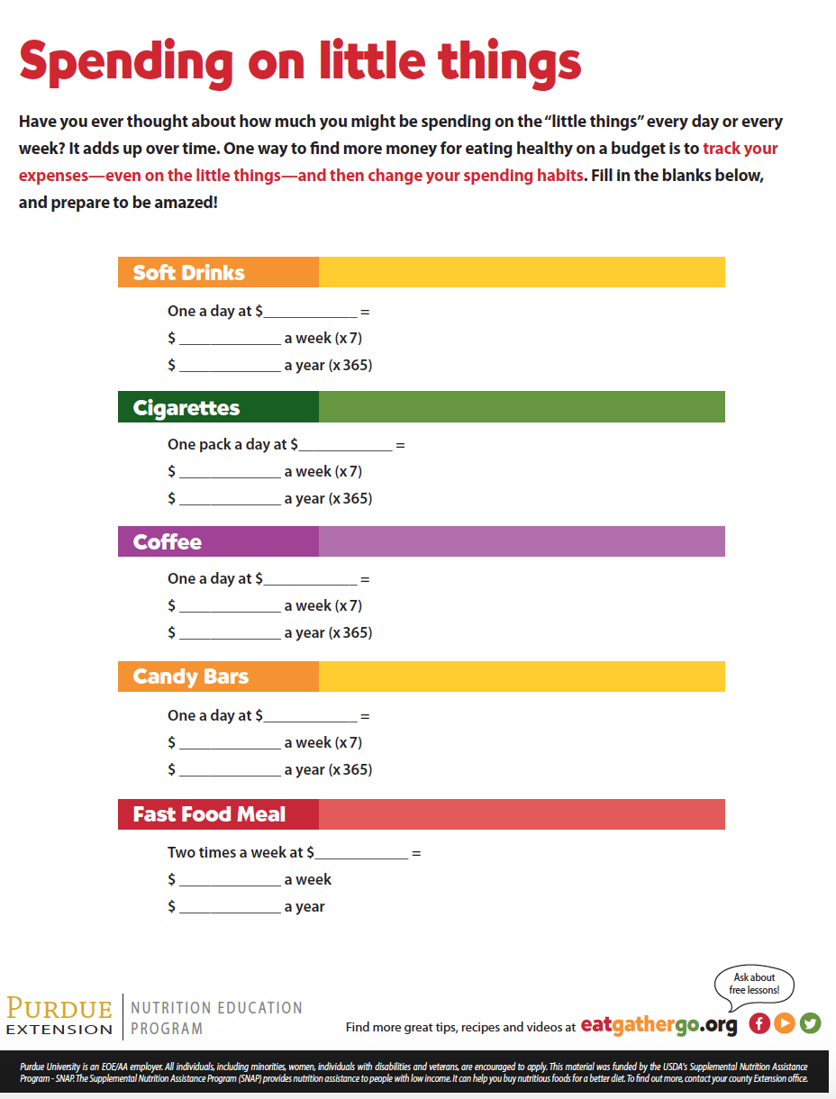

Slide 17
Shopping on a budget

Slide 18
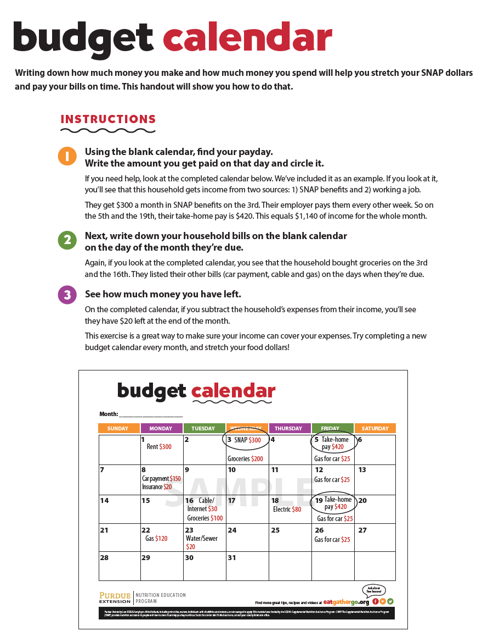
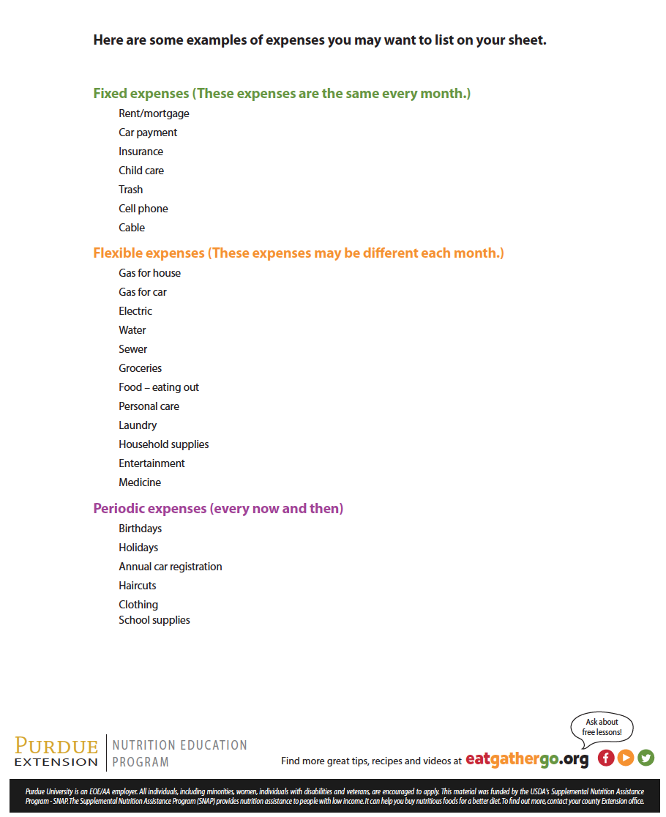

Slide 19
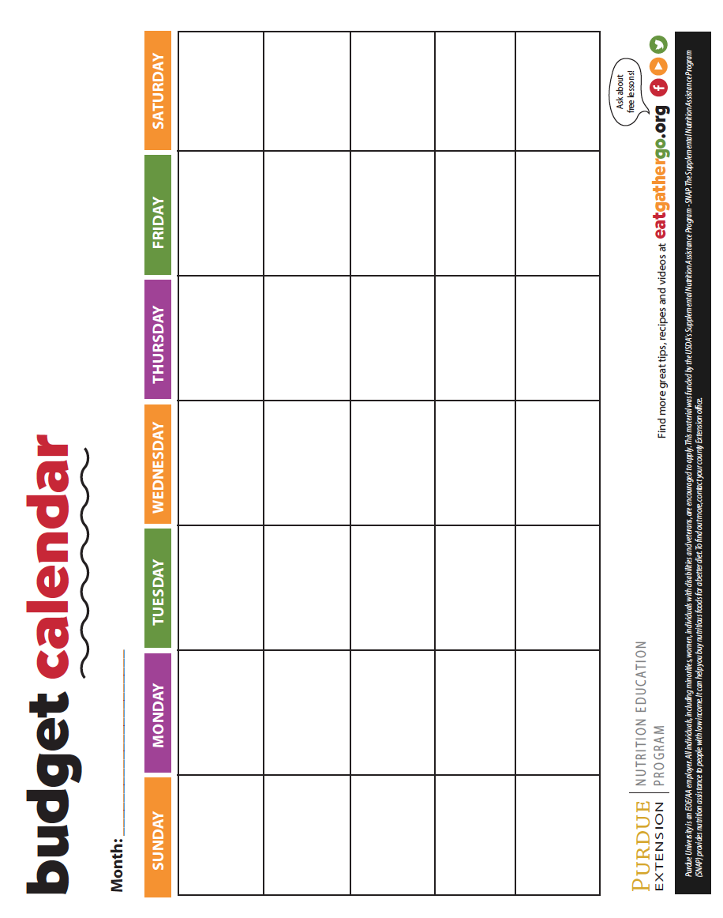

Slide 20
Key Messages
What foods do you want in your community food environment? Ask for them! You have the power!!
Use these tips to ‘Spend Smart Eat Smart’ https://spendsmart.extension.iastate.edu/
Keeping your home food environment well stocked can help save money and help with quick, healthy and sustainable meal preparation
https://extension.psu.edu/a-well-stocked-pantry-equals-a-quick-meal-on-the-table

Slide 21
CLOSING REFLECTION AND GOAL SETTING

