Slide 1
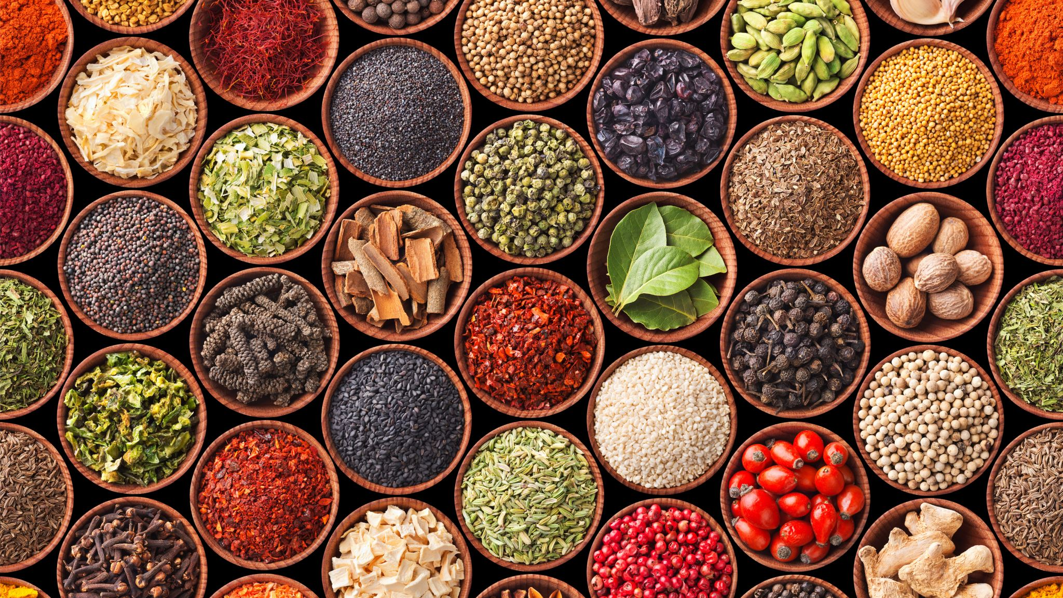
Advancing Healthy and Sustainable Diets for All
Lesson 2: Mindful eating

Slide 2
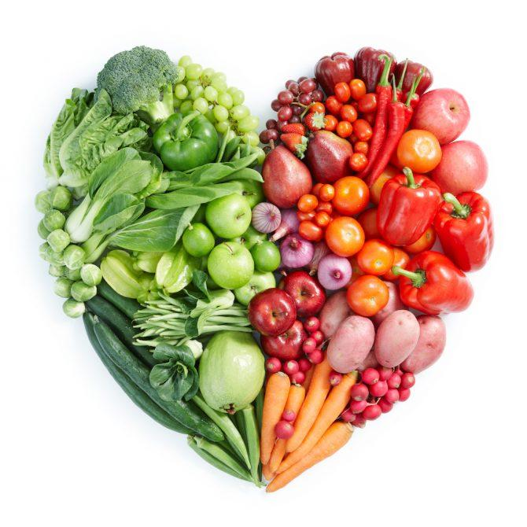
We want to increase access to healthy and sustainable foods by providing your family with healthy and locally-sourced foods over the course of a few months.
RECAP:
PROJECT OBJECTIVES
We want to remove barriers to eating healthy foods by provide food and nutrition classes to enhance knowledge of nutrition and sustainable food systems as well as cooking skills.
We want to understand if increasing access to healthy foods and food and nutrition education will impact your motivation to eat health and your well being.

Slide 3
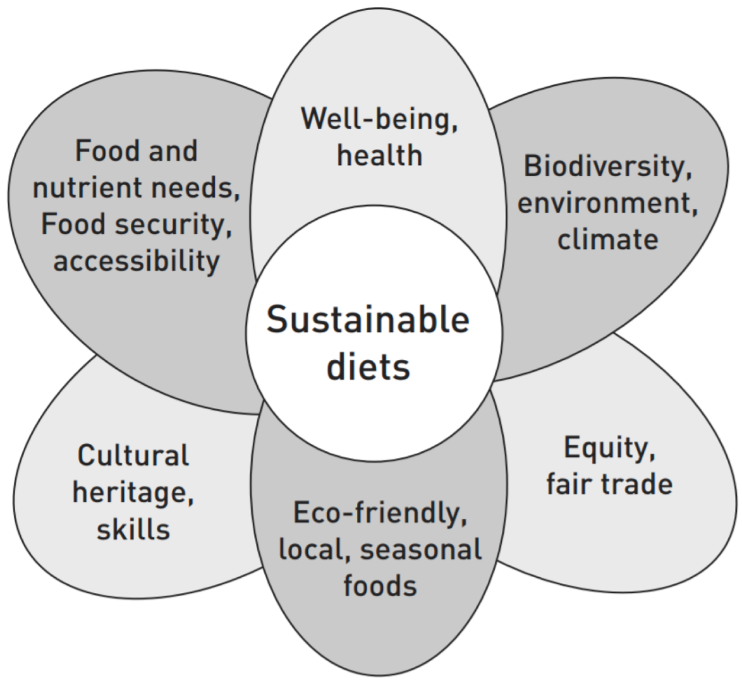

Slide 5
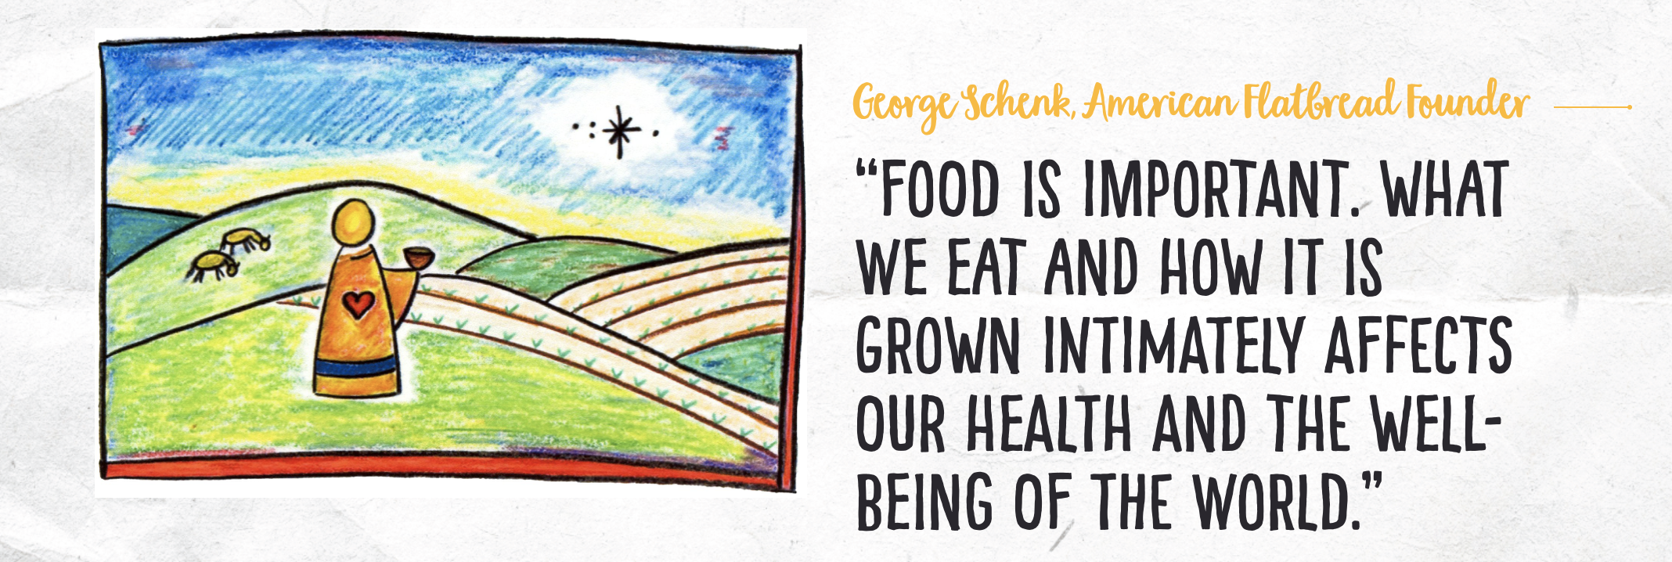

Slide 6
Objectives for Lesson 2: Understand and Practice Mindful Eating
What is mindfulness?
What is mindful eating?

Slide 7
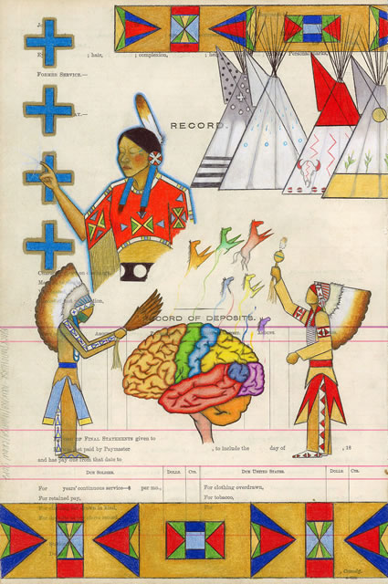
Mindfulness can be viewed as a spiritual practice
Mindfulness is a spiritual practice that, when done regularly, can "transform the fear, anger, and despair in us and overcome the difficulties we encounter in daily...mindfulness is what brings us back in touch with what's happening in the present moment in our body, feelings, in our thinking, and also in our environment.” – Dr. Michael Yellowbird

Slide 8
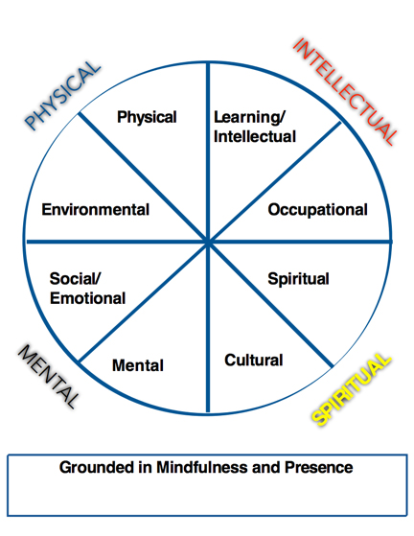

Slide 9
Objectives for Lesson 2: Understand and Practice Mindful Eating
What are ways that you practice and foster mindfulness?

Slide 10
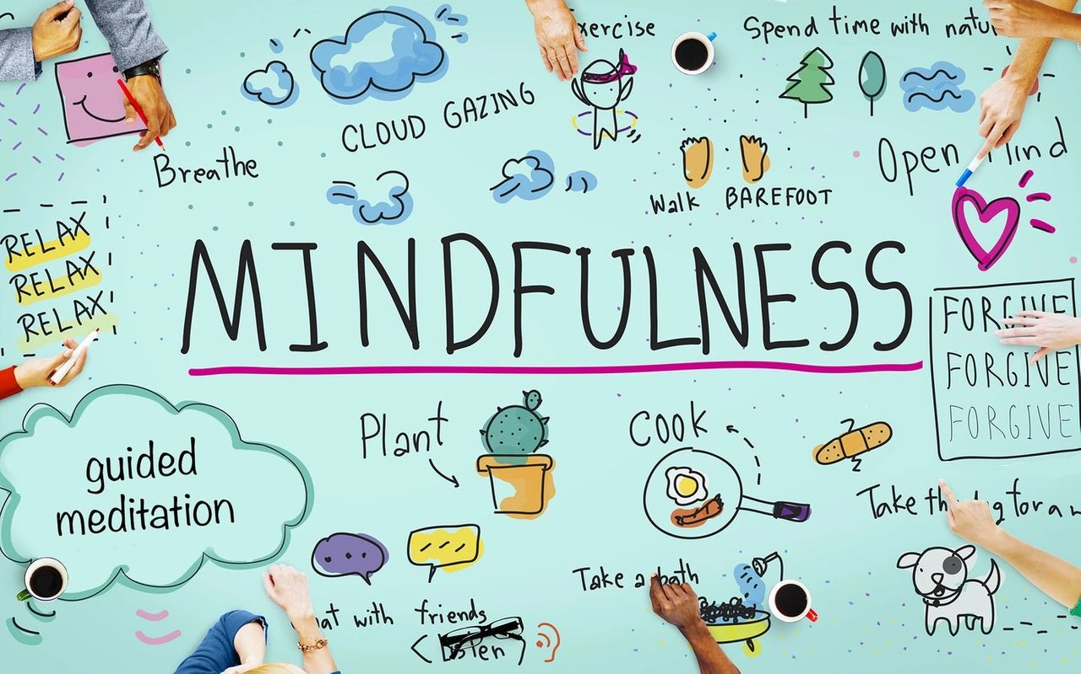

Slide 11
Smudging
Drumming
Flute playing
Nature walks
Building a fire
Harvesting wild foods
Showing gratitude
Fire gazing

Slide 12
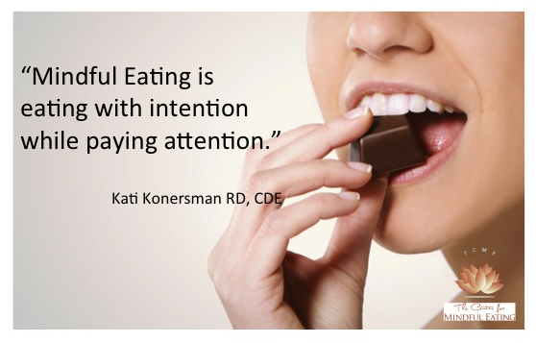
What is mindful eating?
Intuitive eating
Goal is to foster a healthy relationship with foods
We are making dozens of food decisions every day - but we are only aware of a few of them
By bringing awareness to these decisions, we can have more healthy relationship with foods

Slide 13
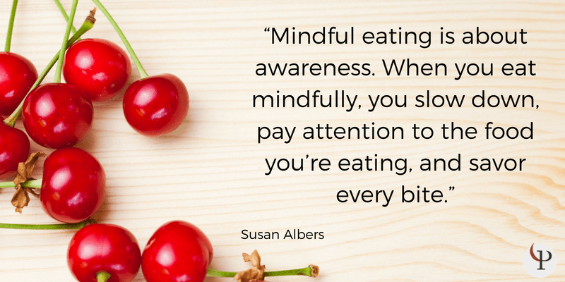

Slide 14
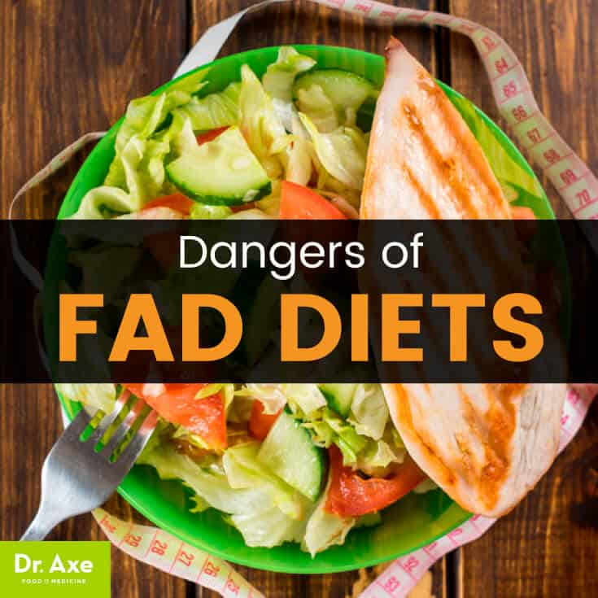
THE CASE FOR MINDFUL EATING
RESTRICTIVE DIETS DON’T WORK!!! ²
About 95% of people who lose weight by dieting will regain it in 1 to 5 years.
Fad diets can limit essential nutrients.
Fad diets can lead to disordered eating behaviors.
Mindful eating is not just how much to eat – but also what we are eating and not eating (food waste) – so our choices can support sustainability of people and the planet

Slide 15
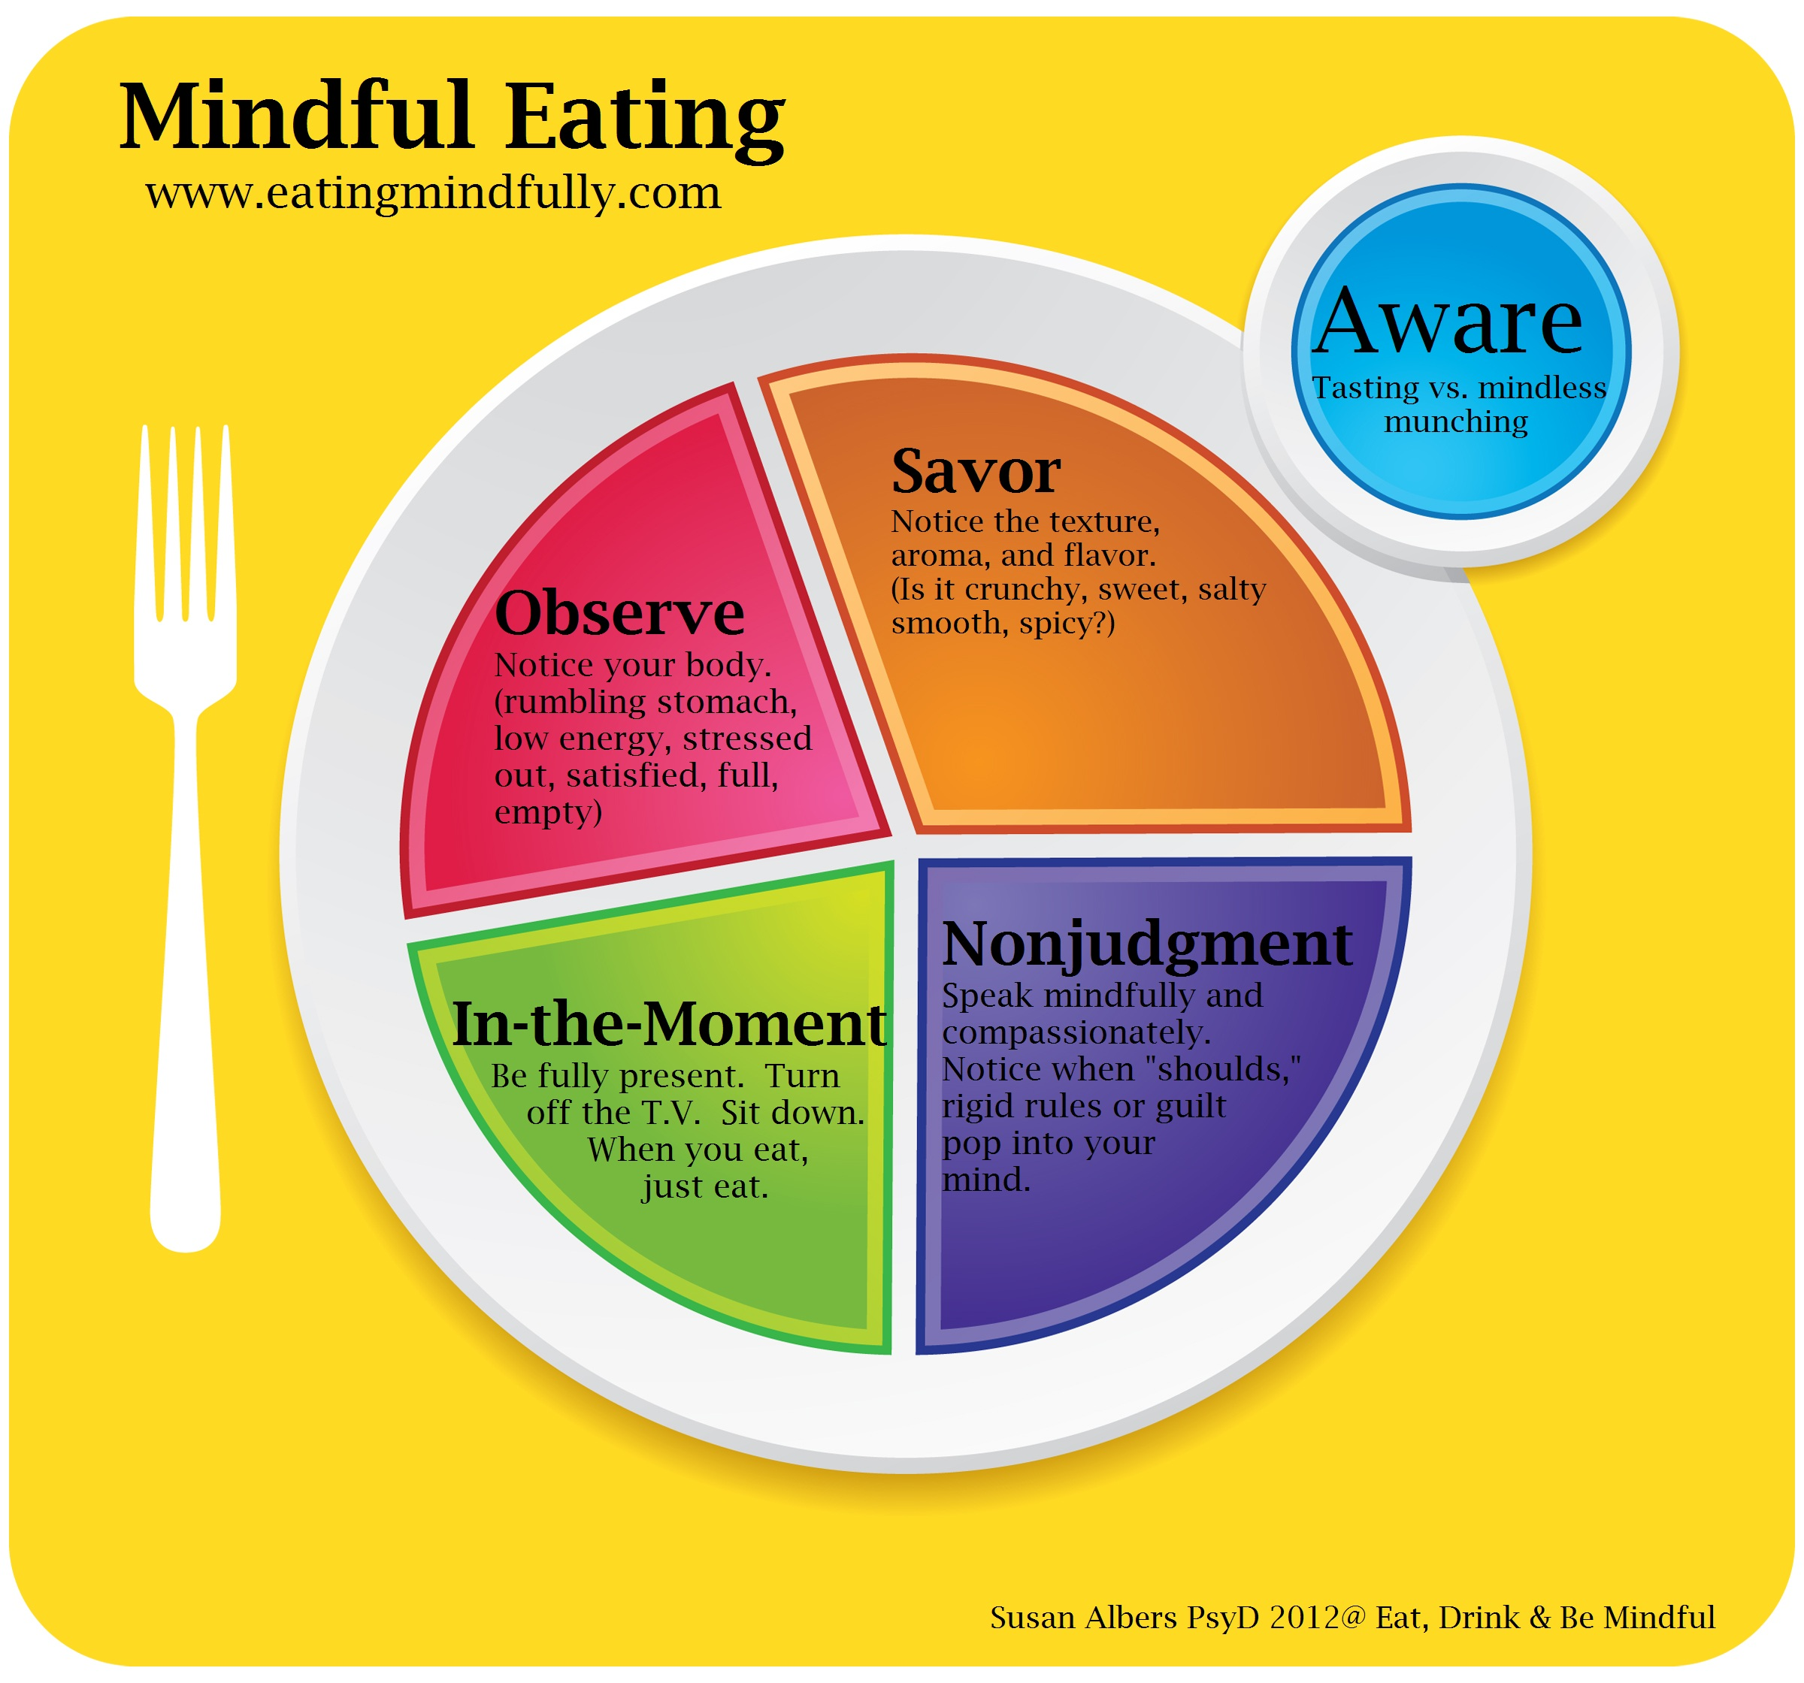
The Mindful Eating Plate
Core concepts of mindful eating:
1) Observe hunger cues – rate your hunger on a scale - eat when your body tells you
2) Savor flavors and textures - helps you be present with your food so you can feel cues of not being hungry
3) Be aware of your eating behaviors
4) Do this WITHOUT judgement – eat the foods you enjoy slowly
5) Be present when you eat – take pauses between bites

Slide 16
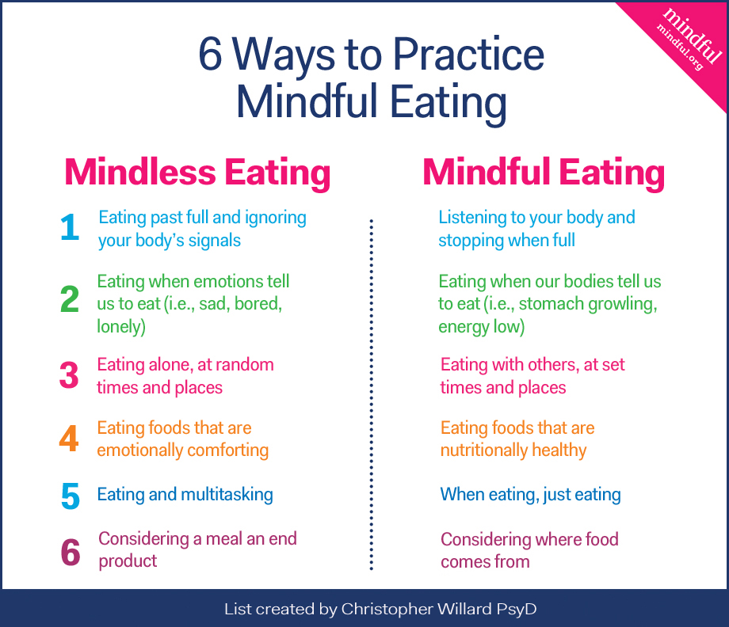
MINDFUL VS. MINDLESS EATING:
SIX COMMON PRACTICES

Slide 17
Slow down eating by eating sitting down with family and community
Share food and appreciate the food of others
Plan your meals ahead of time and explore your food options. What needs to be eaten first to prevent spoiling?
When preparing meals, avoid cherry picking different produce and product parts. Try to use as much of the whole produce and other edibles such as fish.

Slide 18
Start your meal by observing the food and reflecting on its value.
Take a few deep belly breaths and then start eating.
Slowly chew your food and listen to your belly.
Pause and reflect before throwing away food.
Brainstorm if there are other uses for this food. Some foods may be economically cheap and feel easy to throw away, while representing an expensive cost to the environment.
Can you invite friends over to have a leftovers pot luck? Can you compost the food waste?

Slide 19
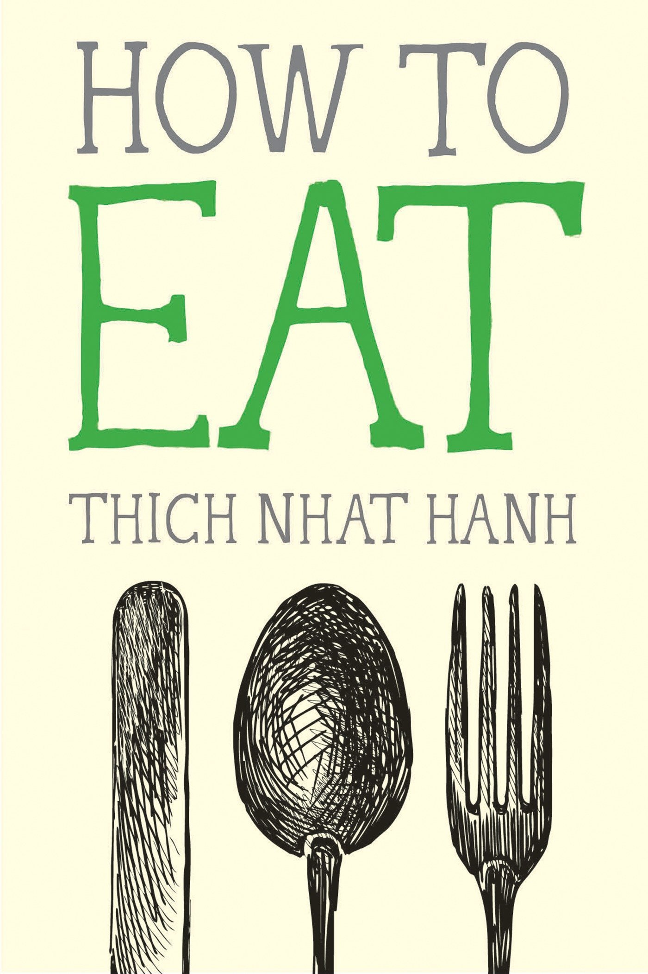
“Don’t chew your worries, your fear, or your anger. If you chew your planning and your anxiety, it’s difficult to feel grateful for each piece of food. Just chew your food.”
― Thich Nhat Hanh, How to Eat

Slide 20
“When we take a moment to sit and breathe before we eat, we can get in touch with the real hunger in our body. We can discover if we’re eating because we’re hungry or if we’re eating because it’s the time to eat and the food is there.”
― Thich Nhat Hanh, How to Eat

Slide 21
“The wheat field needs clouds and sunshine. So in this slice of bread there is sunshine, there is cloud, there is the labor of the farmer, the joy of having flour, and the skill of the baker and then—miraculously!—there is the bread. The whole cosmos has come together so that this piece of bread can be in your hand. You don’t need to do a lot of hard work to get this insight. You only need to stop letting your mind carry you away with worrying, thinking, and planning.”
― Thich Nhat Hanh, How to Eat

Slide 22
“In modern life, people tend to think their bodies belong to them, that they can do anything they want to themselves. But your body is not only yours. Your body belongs to your ancestors, your parents, and future generations. It also belongs to society and to all the other living beings. The trees, the clouds, the soil, and every living thing brought about the presence of your body. We can eat with care, knowing we are caretakers of our bodies, rather than their owners.”
― Thích Nhất Hạnh, How to Eat―

Slide 23
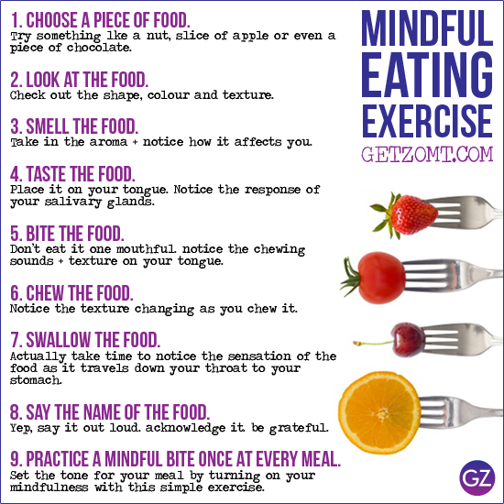

Slide 24
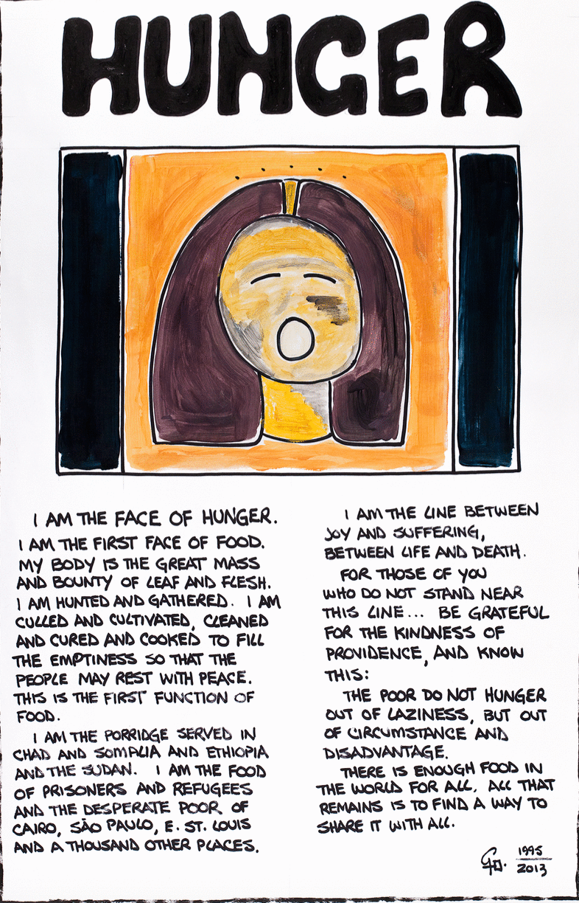

Slide 25
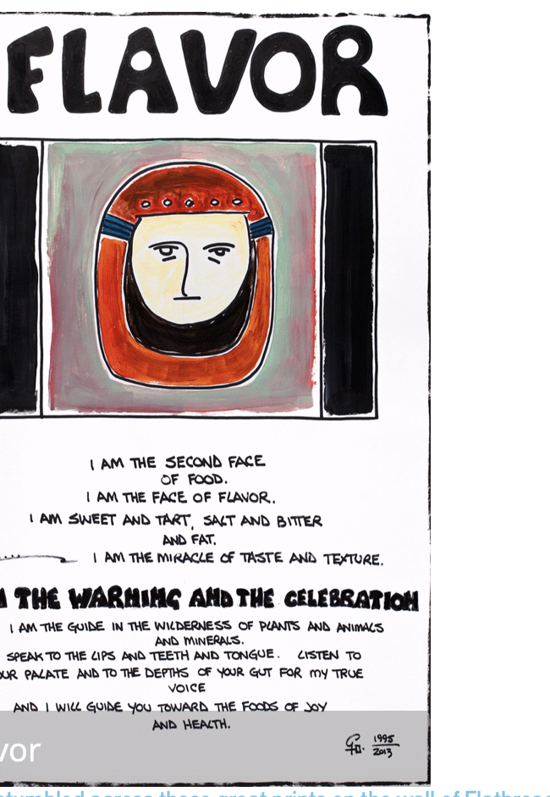

Slide 26
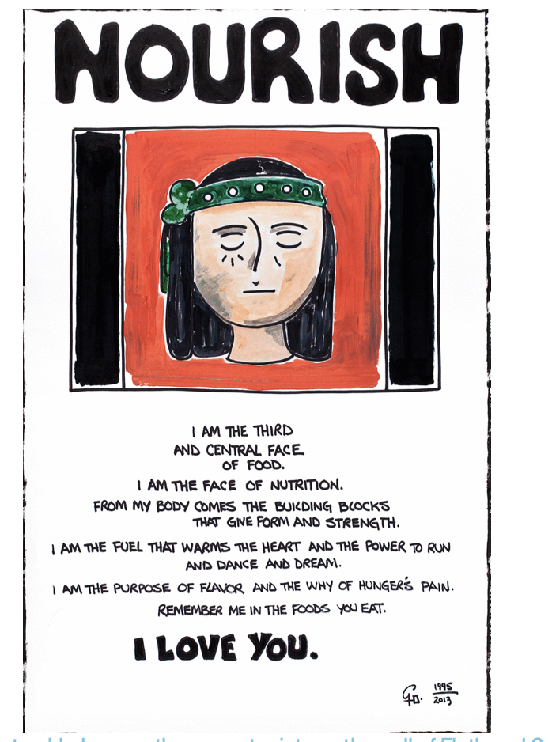

Slide 27
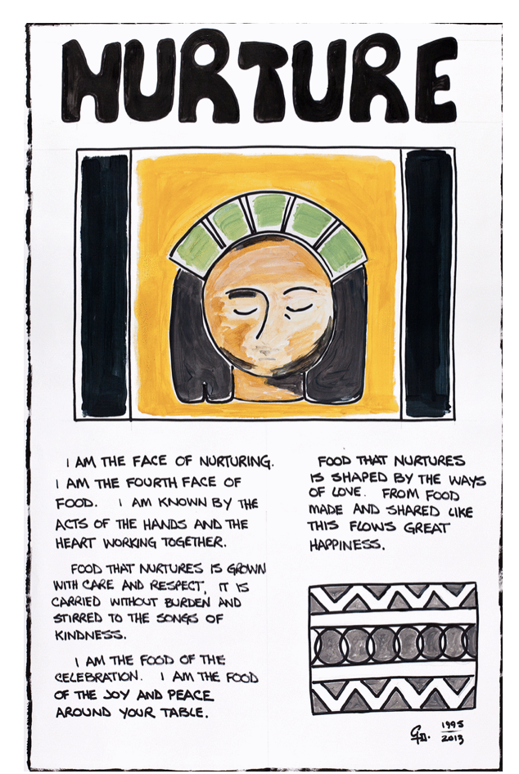

Slide 28
