Slide 1
Advancing Healthy and Sustainable Diets for all
LESSON 5: FOOD AS MEDICINE

Slide 2
REFLECTION
DO YOU THINK YOU ATE BETTER OR WORSE THAN YOU NORMALLY DO OVER THE HOLIDAYS?
WHAT GOALS DID YOU SET TO IMPROVE YOUR DIET OVER THE HOLIDAY SEASON?
WHAT WERE SOME BARRIERS TO ACHIEVING THESE GOALS?
WERE YOU MINDFUL OF YOUR CONSUMPTION?
DID YOU PRACTICE MINDFUL EATING? HOW CAN YOU EAT MORE MINDFULLY IN THE FUTURE?

Slide 3
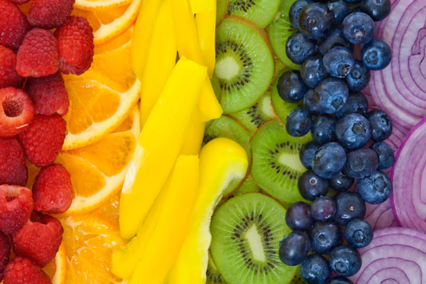
Advancing Healthy and Sustainable Diets for All Lesson Plan #5 – Food as Medicine
What are sustainable diets? “Healthy diets from sustainable food systems that advance the human condition and conserve ecological resources in socially acceptable ways.”¹
What is the goal of this curriculum? To introduce consumers to sustainable diets and food systems concepts and to build capacity for behavior change and system advocacy to advance healthy and sustainable diets for all.

Slide 4
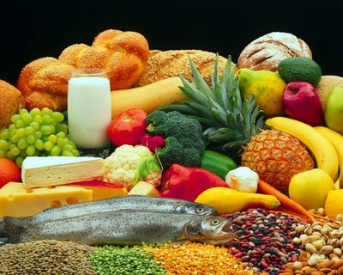
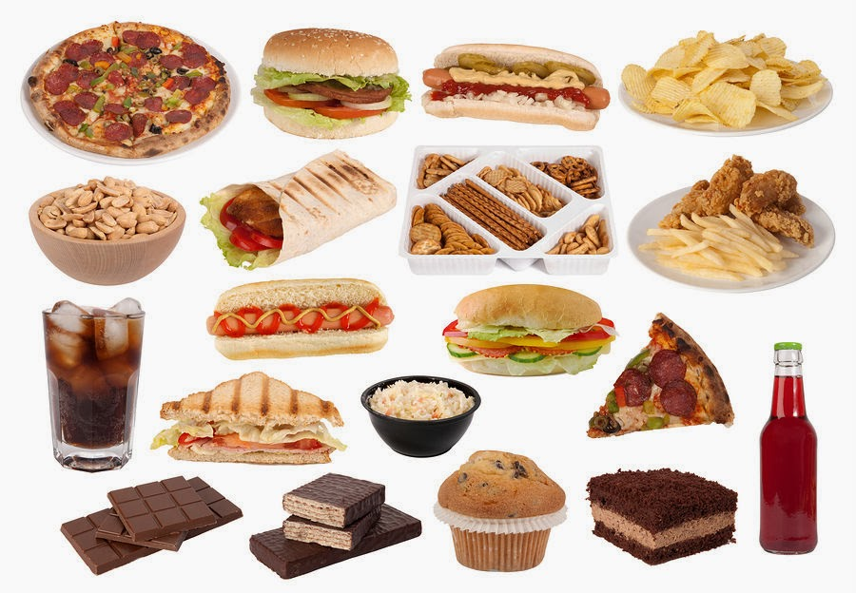
According to the US Dietary Guidelines, Americans eat too much food on the left and not enough on the right.
Foods high in micronutrients (vitamins and minerals)
Foods high in macronutrients (carbohydrates, lipids, fats)
This Photo by Unknown Author is licensed under CC BY-SA-NC
This Photo by Unknown Author is licensed under CC BY

Slide 5
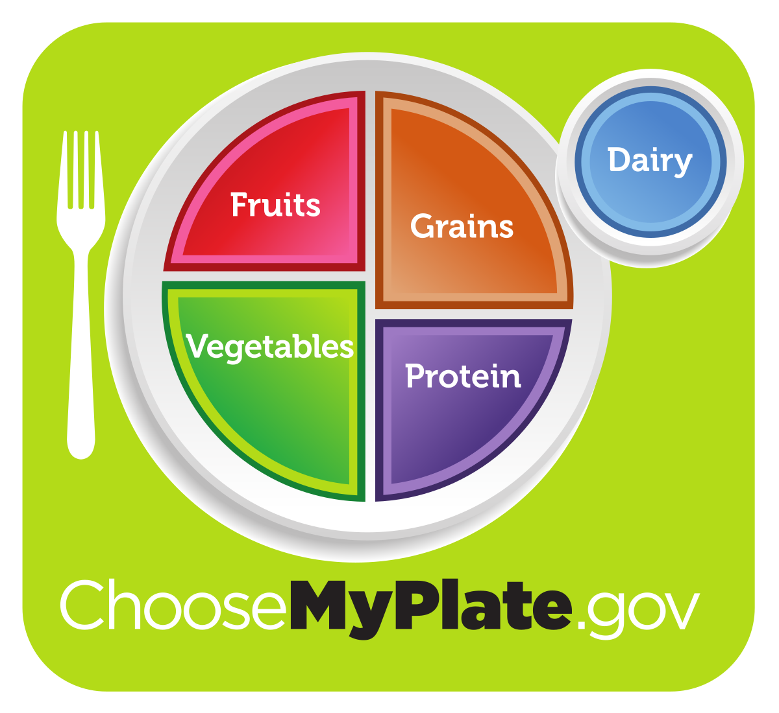
By eating a balanced diet, we can achieve optimal human and environmental health
This Photo by Unknown Author is licensed under CC BY-SA

Slide 6
Activity: Essential Micronutrients
Nutrient | Body Role and/or Health Benefit | Food Sources
Calcium | Bone and teeth health. Necessary for muscles, nerves, and glands. | Dairy products, leafy-green vegetables, fish (with bones), fortified products, and beans/legumes.
Fiber | Reduced risk for coronary heart disease, maintains healthy bowels | Fruits and vegetables and whole grains.
Folate | Reduced risk for birth defects in the brain or spinal cord. | Liver, asparagus, oranges, beans/legumes, and fortified products.
Magnesium | Bone health and normal body functioning. | Nuts, seeds, leafy-green vegetables, bananas, whole grains.
Potassium | Maintenance of a healthy blood pressure. | Fruits and vegetables
Sodium | Needed for normal cellular functioning, although most people consume too much. | Highly and ultra-processed foods and beverages, sauces and gravies.

Slide 7
Nutrient | Body Role/Health Benefit | Food Sources
Vitamin C | Wound healing and healthy gums and teeth. | Citrus fruits, bell peppers, leafy-green vegetables.
Vitamin A | Eye, skin, and immune system health | Liver, egg yolks, fish, and dark orange fruits and vegetables
Vitamin D | Heart, bone, immune system, and nervous system health | Fish, dairy, eggs.
Beta-carotene | Immune system, vision, skin, and bone health | Pumpkin, Sweet Potato, Carrots, Winter Squash, Cantaloupe, Apricots, Spinach, Collard Greens, Kale, Broccoli.
Lycopene | Reduced risk for prostate cancer and heart health | Tomatoes and Tomato Products, Pink Grapefruit, Red Peppers, Watermelon.
Lutein | Eye and heart health and reduced risk for some cancers. | Collard Greens, Kale, Spinach, Broccoli, Brussels Sprouts, Lettuces, Artichokes.
Resveratrol | Heart and lung health and reduced risk for some cancers. Reduced inflammation. | Peanuts and grapes.
Anthocyanidins | Blood vessel health and reduced risk for some cancers. | Blueberries, Blackberries, Plums, Cranberries, Raspberries, Red Onions, Red Potatoes, Red Radishes, Strawberries.
Isoflavones | Bone and joint health, lower cholesterol, and reduced risk for breast cancer and inflammation. | Soybeans, tofu.

Slide 8
Activity: Nutrient Density
Scientists have identified which fruits and vegetables have the highest nutrient density. Can you guess what they are??

Slide 9
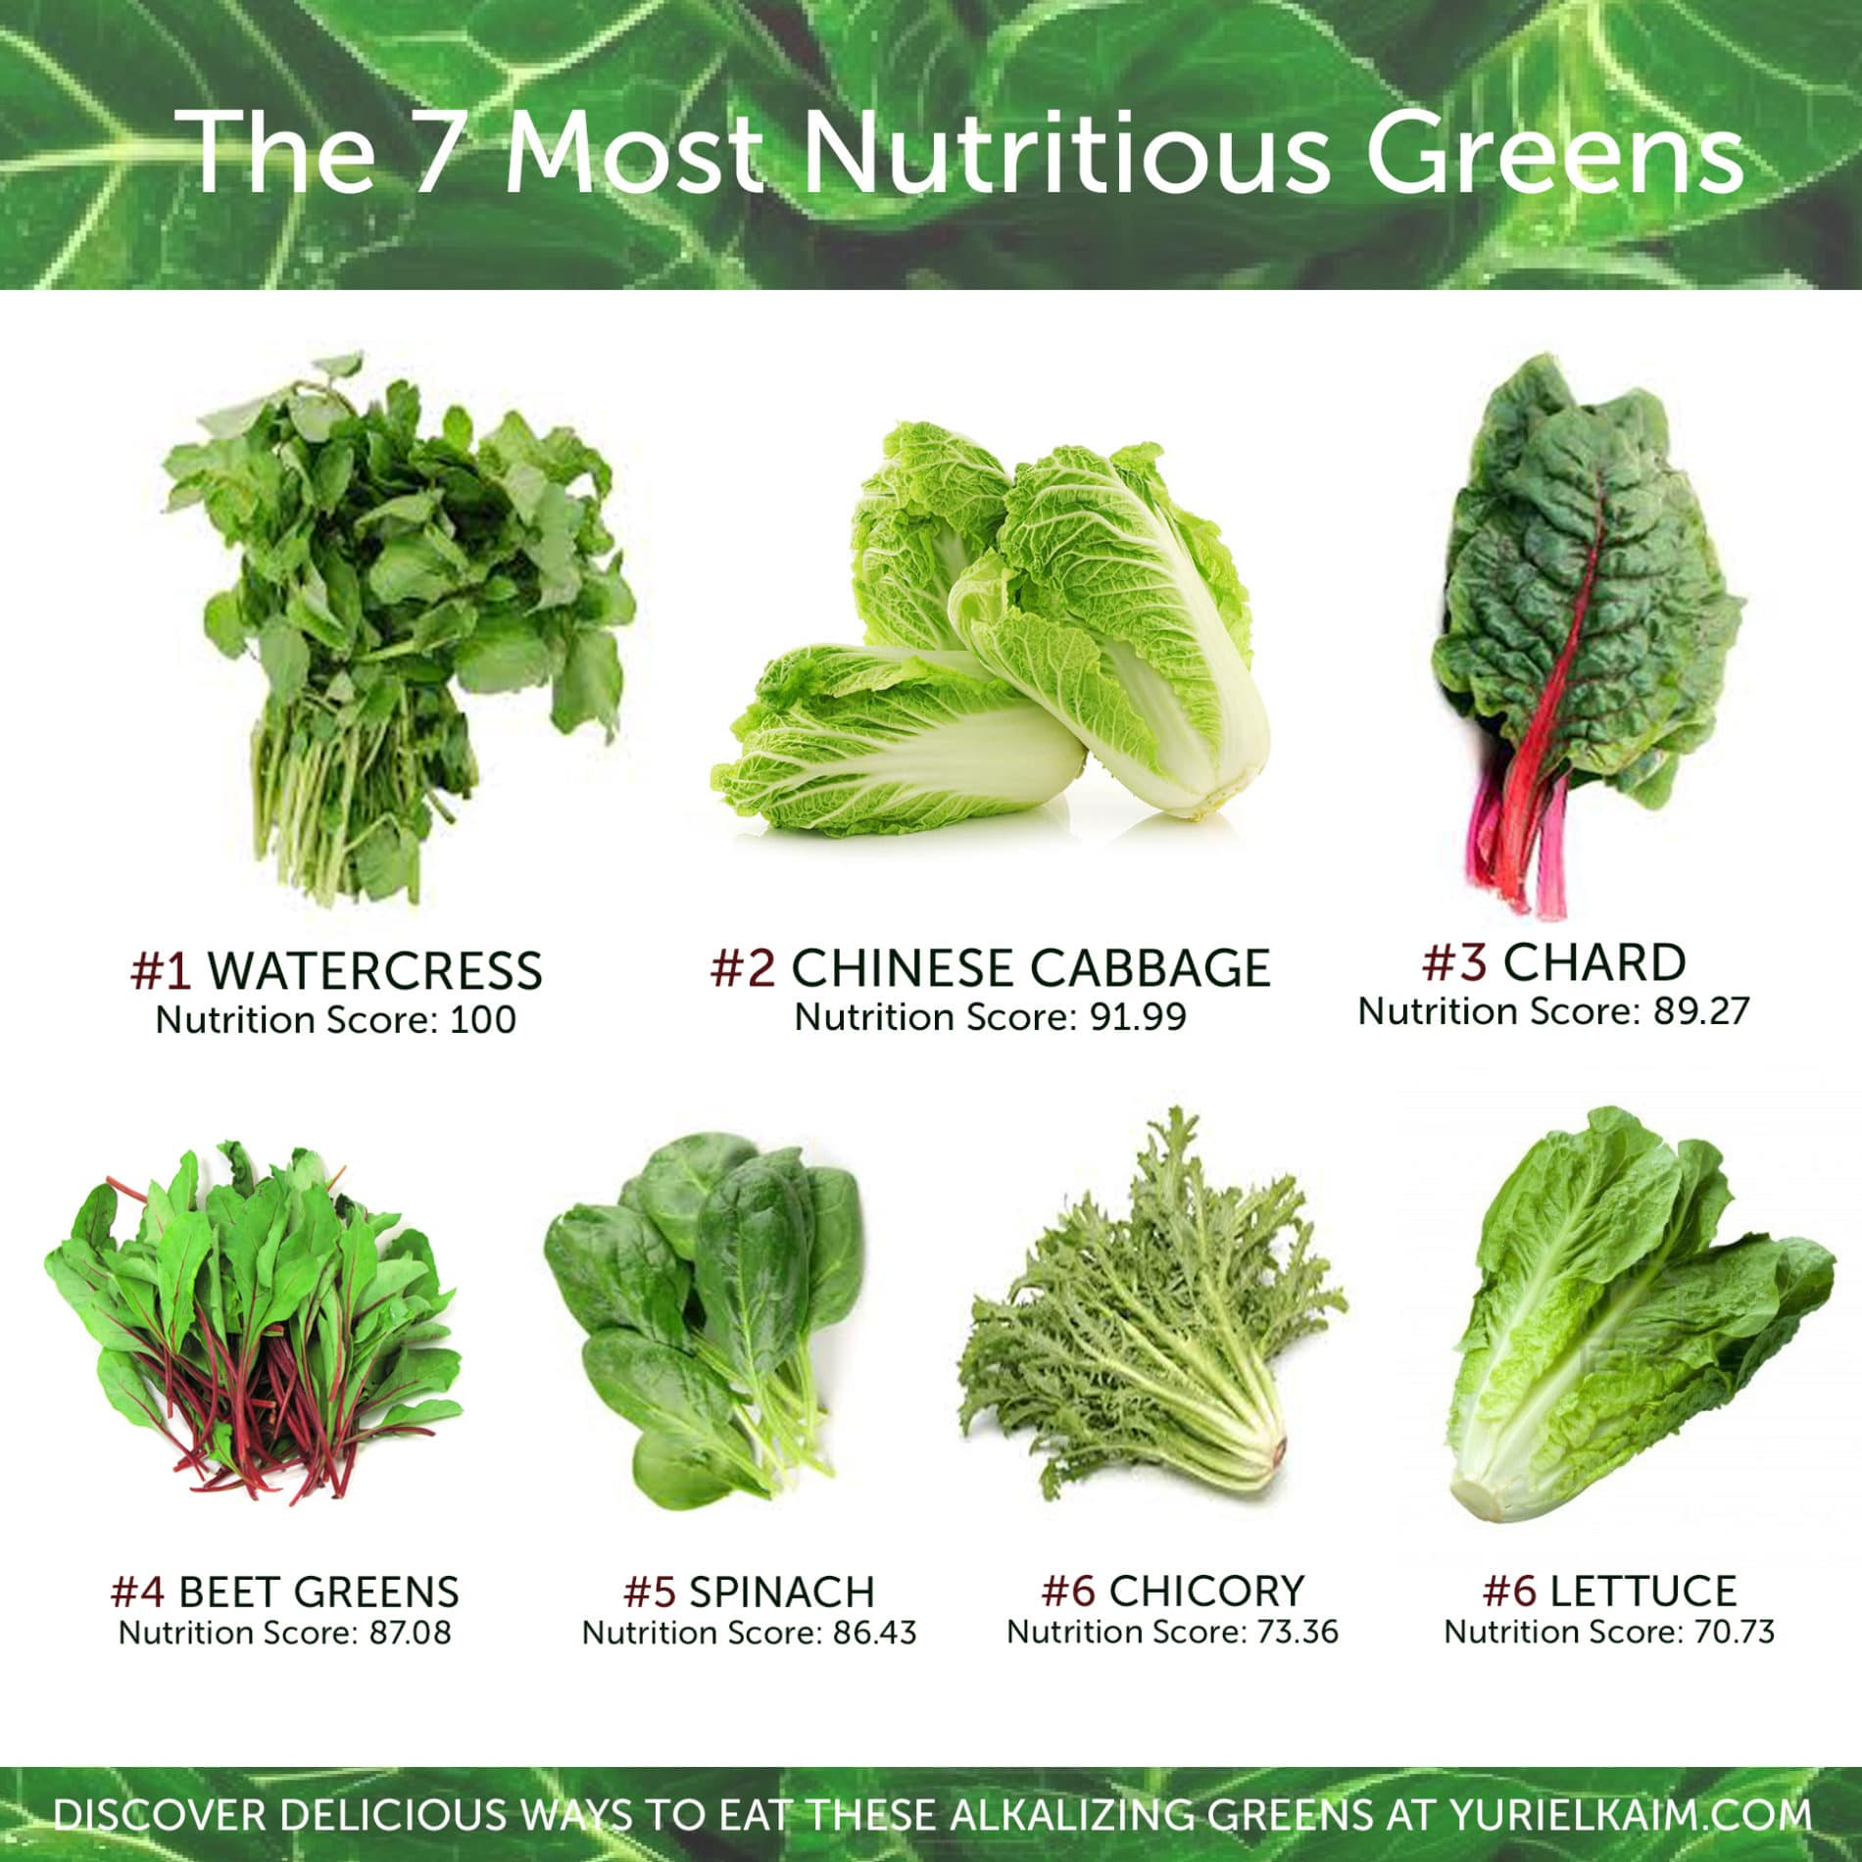
Activity: Nutrient Density
Scientists have identified which fruits and vegetables have the highest nutrient density. Can you guess what they are??

Slide 10
Closing reflection and goal setting

